Slide 1

ROS-based Autonomous Navigation with Obstacle Avoidance
Guide:
Dr. Chandra Prakash Meena
Assistant Professor, Department of CSE, NIT Surat
Presented By:
Vaibhav Gupta | U22CS029
Akshat Sahu| U22CS034
Nikhil Malgaya| U22CS039
Sangam Birla| U22CS40

Slide 2
Content
Problem Statement
Objectives
Assumption
Agent Introduction
AI Module Used
Working Video
Our Learning

Slide 3
Problem Statement
Develop an Obstacle Avoiding Robot using Gazebo and also implemented on Tinkercad, capable of autonomously navigating environments while avoiding obstacles and reaching the goal state.

Slide 4
Objectives
Autonomous Navigation: The robot should be able to move towards a predefined goal location specified in terms of x and y coordinates.
Obstacle Avoidance: The robot should navigate around obstacles detected by a laser scanner. It uses laser scan data to determine the presence and location of obstacles and adjusts its movement accordingly to avoid collisions.
Proportional Control: The code implements a proportional controller to rotate the robot to a target angle, ensuring accurate alignment with the desired orientation.
Goal Reaching: Once the robot reaches the specified goal location within a defined threshold, it should stop and signal that the goal has been reached.
Dynamic Behavior: The robot's movement behavior should dynamically adjust based on real-time sensor readings to navigate efficiently through the environment while avoiding obstacles.

Slide 5
Assumptions
The robot's wheels are perfectly round and do not slip.
The robot's sensors are accurate and free from noise.
The environment is static and does not change over time.
The robot is the only moving object in the environment.

Slide 6
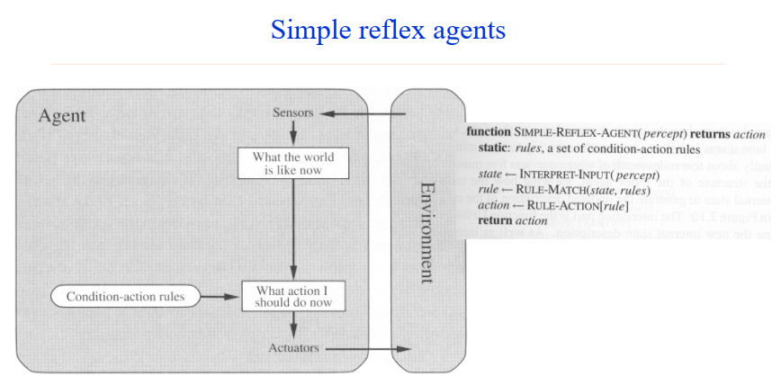
Agent Introduction

Slide 7
Input
Goal Coordinates:
Target destination coordinates (x, y) within the map frame.
Laser Scan Data:
Measurements of distances to obstacles in the robot's surroundings.
Proportional Control Parameters:
Proportional gain for orientation alignment during rotation.
ROS Topics and Messages:
Subscription to laser scan and odometry topics, publication to velocity control topic (/cmd_vel).

Slide 8
Output
Velocity commands published to /cmd_vel topic for robot movement control.
Logging and debug information, including current position, orientation, and obstacle detection.
Goal reached signal, indicating when the robot has reached the specified destination.

Slide 9
Components Used
Arduino Uno or similar microcontroller board for program execution and control.
Ultrasonic sensor (HC-SR04 or similar) for distance measurement and obstacle detection.
LiquidCrystal display (16x2) for real-time feedback and status display.
Motors and motor driver (L298N or similar) for controlling the movement of the robot's wheels.
Breadboard and jumper wires for circuit connections.
Power source (battery or power supply) to power the Arduino, motors, and other components.

Slide 10
AI Module Used
Module 2: Automated Problem Solving Agent
Module 3: Search Strategies

Slide 11
P.E.A.S.
Performance Measure:
Goal Achievement: How effectively the robot reaches its destination while avoiding obstacles.
Collision Avoidance: Ability to steer clear of obstacles and prevent crashes.
Efficiency: How smoothly and quickly the robot moves towards its goal.
Adaptability: Ability to handle changes in the environment and unexpected situations.

Slide 12
P.E.A.S.
Environment:
Indoor or outdoor spaces with obstacles like walls, furniture, or other objects.
static obstacles are present.
Conditions like terrain roughness, lighting, and sensor reliability may vary.

Slide 13
P.E.A.S.
Actuators:
Adjusts the robot's speed and direction to control its movement(Motor).
Rotates the robot to align with desired angles during navigation.

Slide 14
P.E.A.S.
Sensors:
Detects obstacles around the robot.
Provides information about the robot's position and orientation.
Input specifies the destination for navigation.

Slide 15
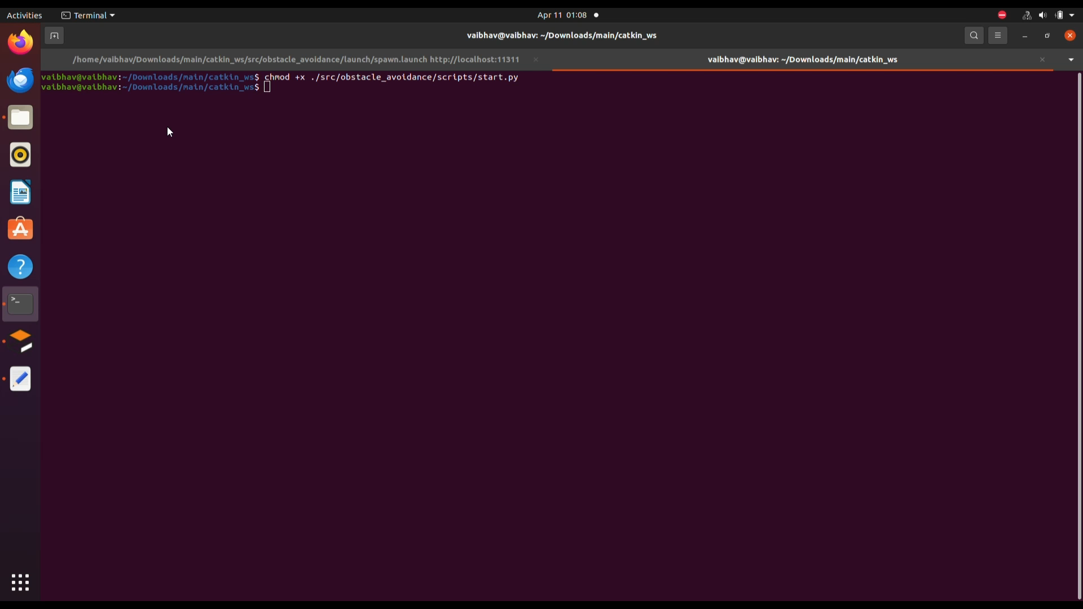
Model Video - 1
GOAL : (10,10)

Slide 16
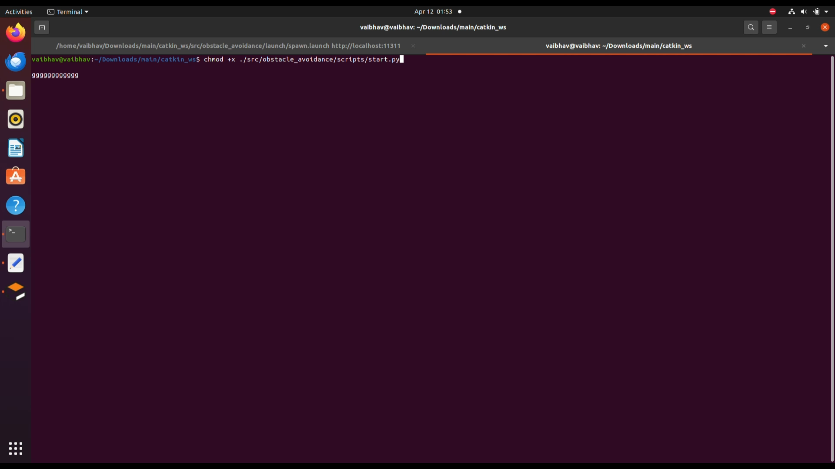
Model Video - 2
GOAL : (5,0)

Slide 17
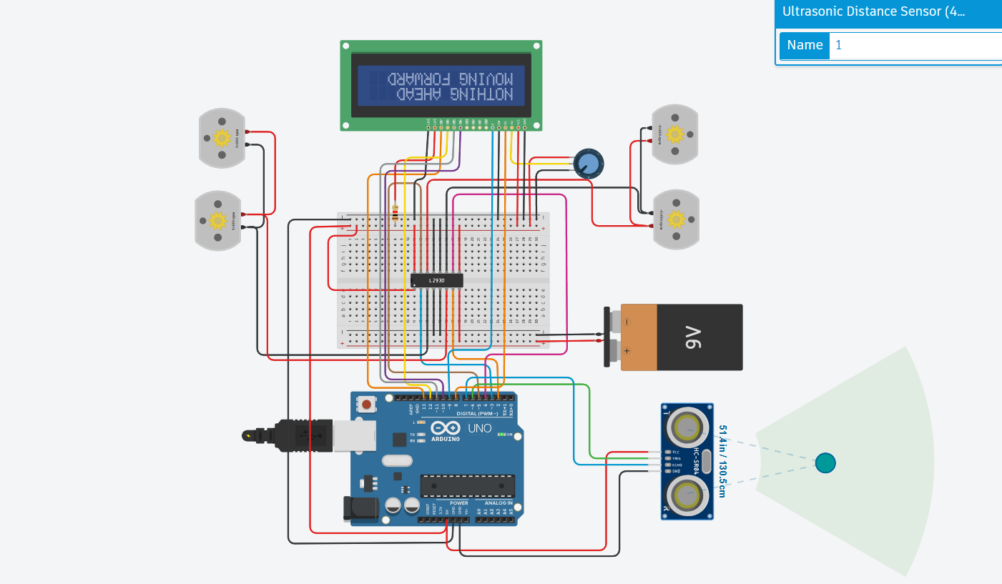
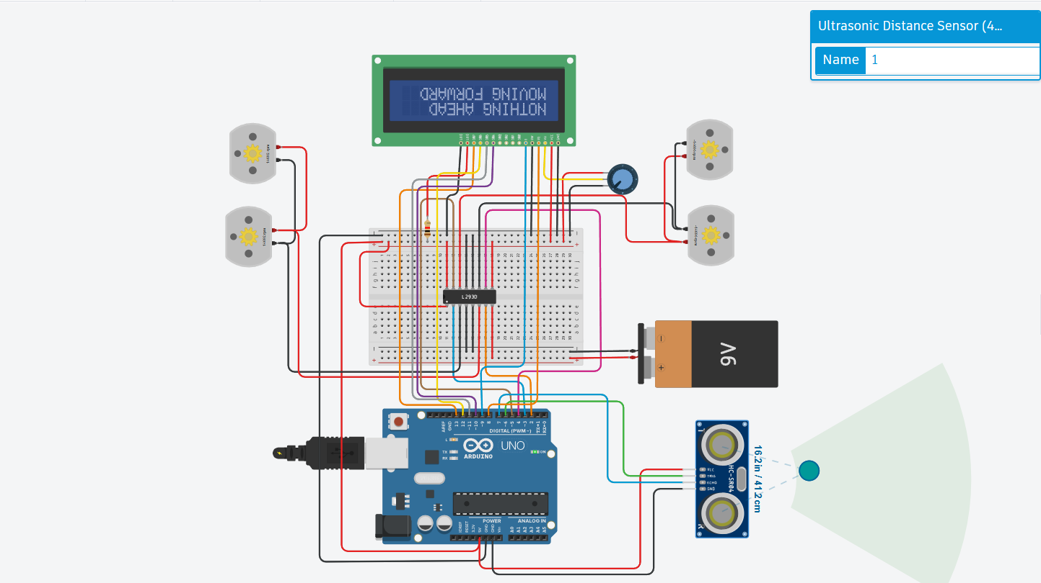
ThinkerCad Model Pictures (No Obstacle)

Slide 18
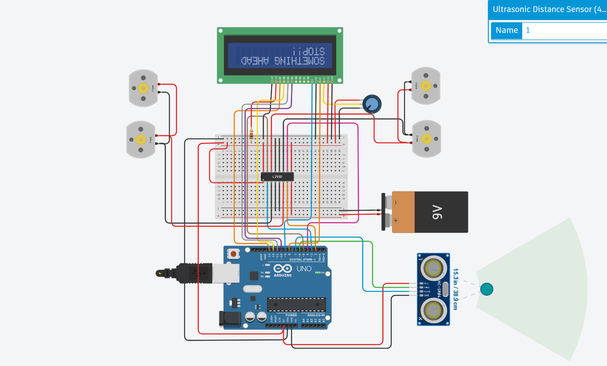
ThinkerCad Model Pictures(Obstacle)

Slide 19
Our learning
Proportional Control Optimization
Dynamic Obstacle Handling
Goal Reaching Algorithm
Sensor Data Processing
Working on Robot Operating System(ROS) and Gazebo.

Slide 20
References
Arduino Docs:
Website Title: Arduino Documentation
URL: https://www.arduino.cc/en/Reference/HomePage
ROS Wiki:
Website Title: Documentation - ROS Wiki
URL: http://wiki.ros.org/Documentation

